Slide 1
Electronic Health Records Data Collection
N.S.Gajayavahini (C3S48951)
M.R.Vanmathi(C3S48954)
G.N.Monisha (C3S48953)
R.Akash(C3S48955)
Notes:
Entered text
Data Collection Of Electronic Health Records

Slide 2
Electronic Health Records
Data Collection
This presentation provides an overview of the process and importance of data collection of a patient’s details in electronic health records from NHS

Slide 3
Introduction
Definition of electronic health records
Importance of data collection
Purpose of the presentation

Slide 4
Introduction of NHS
NHS(National Health Services) refer to healthcare systems that provide medical and health services to all residents of a country, typically funded through taxes and government resources. They aim to ensure equitable access to healthcare,regardless of individual’s financial status. These services often cover a wide range of medical needs, from preventive care to treatment of illnesses and emergencies. National health services vary in structure and funding across countries but generally prioritize universal coverage and public health outcomes.

Slide 5
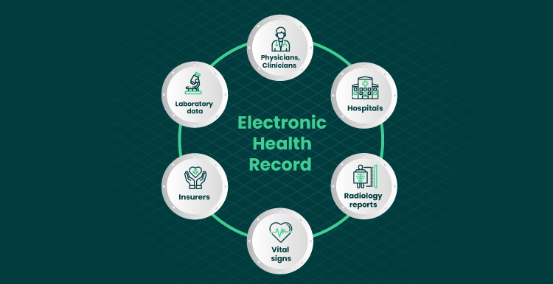
Benefits of Electronic Health Records
Improved patient care
Efficient record keeping
Enhanced communication
Decision support

Slide 6
Types of Data in Electronic Health Records
Medications
Patient demographics
Medical history
Laboratory results
Imaging studies

Slide 7

Challenges in Data Collection
Data privacy and security:
Ensuring compliance with strict data protection laws(such as GDPR in Europe) adds complexity to collecting, storing and sharing patient information securely.
Fragmentation of systems:
The NHS comprises multiple hospitals, clinics and healthcare providers,each with its own information system. Integrating these systems to obtain a comprehensive patient record can be challenging.

Slide 8
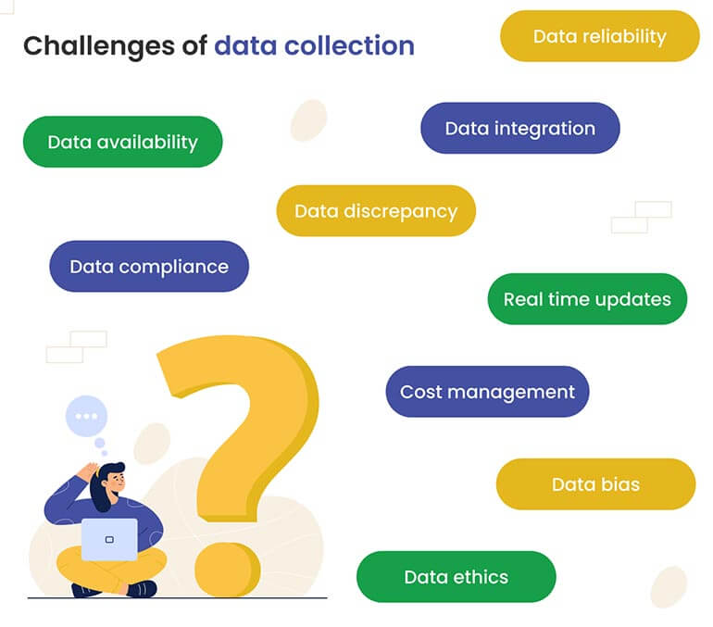
Challenges in Data Collection
Ethical considerations:
Balancing the benefits of data collection with patient privacy concerns and ethical considerations is essential
Consent and Permission:
Obtaining patient consent for data collection and sharing, especially across different NHS organizations, requires clear and transparent communication.

Slide 9
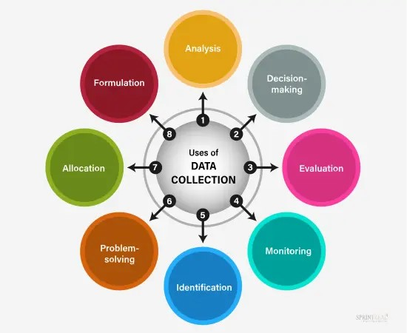
Skills developed by collecting data
Data Management:
Skills in organizing,storing and retrieving large volumes of healthcare data.
Analytical Skills:
Ability to analyze data, identify trends, and make informed decisions.
Problem solving:
Addressing challenges related to data accuracy, interoperability, and system integration.
Ethics and Compliance:
Understanding and applying ethical principles and legal standards in healthcare data collection and management.

Slide 10
Data Analysis and Utilization
Clinical research
Quality improvement initiatives
Population health management
Public health monitoring

Slide 11
Conclusion
Summary of key points
Importance of data collection in electronic health records
Opportunities and challenges

Slide 12
Thank you for your time 😊

